Slide 1
External Sorting
Chapters 13: 13.1—13.5
Notes:
1
The slides for this text are organized into chapters. This lecture covers Chapter 11.
Chapter 1: Introduction to Database Systems
Chapter 2: The Entity-Relationship Model
Chapter 3: The Relational Model
Chapter 4 (Part A): Relational Algebra
Chapter 4 (Part B): Relational Calculus
Chapter 5: SQL: Queries, Programming, Triggers
Chapter 6: Query-by-Example (QBE)
Chapter 7: Storing Data: Disks and Files
Chapter 8: File Organizations and Indexing
Chapter 9: Tree-Structured Indexing
Chapter 10: Hash-Based Indexing
Chapter 11: External Sorting
Chapter 12 (Part A): Evaluation of Relational Operators
Chapter 12 (Part B): Evaluation of Relational Operators: Other Techniques
Chapter 13: Introduction to Query Optimization
Chapter 14: A Typical Relational Optimizer
Chapter 15: Schema Refinement and Normal Forms
Chapter 16 (Part A): Physical Database Design
Chapter 16 (Part B): Database Tuning
Chapter 17: Security
Chapter 18: Transaction Management Overview
Chapter 19: Concurrency Control
Chapter 20: Crash Recovery
Chapter 21: Parallel and Distributed Databases
Chapter 22: Internet Databases
Chapter 23: Decision Support
Chapter 24: Data Mining
Chapter 25: Object-Database Systems
Chapter 26: Spatial Data Management
Chapter 27: Deductive Databases
Chapter 28: Additional Topics

Slide 2
Why Sort?
A classic problem in computer science (See Knuth, v.3)!
Data requested in sorted order
  e.g., find students in increasing gpa order
Sorting is first step in bulk loading B+ tree index.
Sorting useful for eliminating duplicate copies in a collection of records (Why?)
Sort-merge join algorithm involves sorting.
Problem: sort 1Gb of data with 1Mb of RAM.
  why not virtual memory?
Notes:
4

Slide 3
2-Way Merge Sort: Requires 3 Buffers
Pass 1: Read a page, sort it (in memory), write it.
  only one buffer page is used
Pass 2, 3, …, etc.:
  three buffer pages used.
INPUT 1
OUTPUT
INPUT 2
Main memory buffers
Disk
Disk
Notes:
5

Slide 4
2-Way Merge Sort: Algorithm
proc two-way_extsort(file)
// Given a file on disk, sort it using 3 buffer pages
//Pass 0: produce 1-page runs
Read each page of file into memory, sort it, and write it out.
//Merge pairs of runs to produce longer runs until 1 run is left
While # of runs at end of previous pass > 1 do:
//Process passes i=1,2,…
While there are runs to be merged from previous pass do:
Pick next 2 runs from previous pass.
Reach read each run into an input buffer, 1 page at a time.
Merge the runs and write result to the output buffer by
forcing output buffer to disk one page at a time.
endproc
Notes:
4

Slide 5
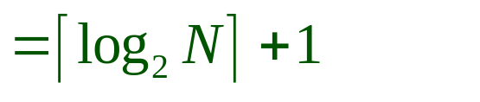
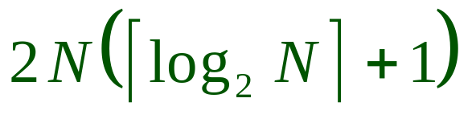
Two-Way External Merge Sort
Each pass we read + write each page in file => 2N I/O’s per pass.
N pages in the file => the number of passes
So total cost is:
Idea: Divide and conquer: sort subfiles and merge
Input file contains 7 pages; dark pages shows what would happen with 8 pages.
3,4
6,2
9,4
8,7
5,6
3,1
2
Input file
PASS 0
3,4
2,6
4,9
7,8
5,6
1,3
2
1-page runs
PASS 1
2,3
4,7
1,3
2-page runs
4,6
8,9
5,6
2
PASS 2
2,3
4,4
1,2
4-page runs
6,7
3,5
8,9
6
PASS 3
1,2
2,3
3,4
8-page runs
4,5
6,6
7,8
9
Notes:
6

Slide 6
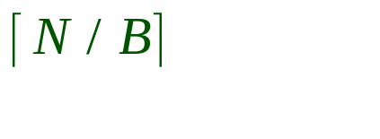
General External Merge Sort
More than 3 buffer pages. How can we utilize them?
To sort a file with N pages using B buffer pages:
  Pass 0: use B buffer pages. Produce sorted runs of B pages each.
  Pass 2, …, etc.: merge B-1 runs.
INPUT 1
. . .
INPUT 2
. . .
. . .
OUTPUT
INPUT B-1
Disk
Disk
B Main memory buffers
Notes:
7

Slide 7
General External Merge Sort: Algorithm
proc extsort(file)
// Given a file on disk, sort it using B buffer pages
//Pass 0: produce B-pages runs
Read B pages of file into memory, sort them, and write them out.
//Merge B-1 runs to produce longer runs until 1 run is left
While # of runs at end of previous pass > 1 do:
//Process passes i=1,2,…
While there are runs to be merged from previous pass do:
Pick next B-1 runs from previous pass.
Reach read each run into an input buffer, 1 page at a time.
Merge the runs and write result to the output buffer by
forcing output buffer to disk one page at a time.
endproc
Notes:
4

Slide 8
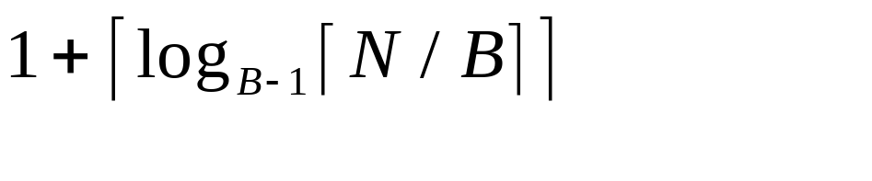
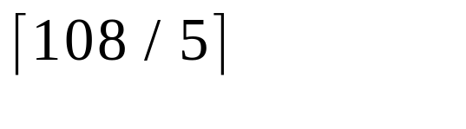
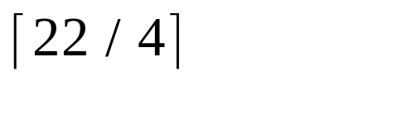
Cost of External Merge Sort
Number of passes:
Cost = 2N * (# of passes)
E.g., with 5 buffer pages, to sort 108 page file:
  Pass 0: = 22 sorted runs of 5 pages each (last run is only 3 pages)
  Pass 1: = 6 sorted runs of 20 pages each (last run is only 8 pages)
  Pass 2: 2 sorted runs, 80 pages and 28 pages
  Pass 3: Sorted file of 108 pages
Notes:
8

Slide 9
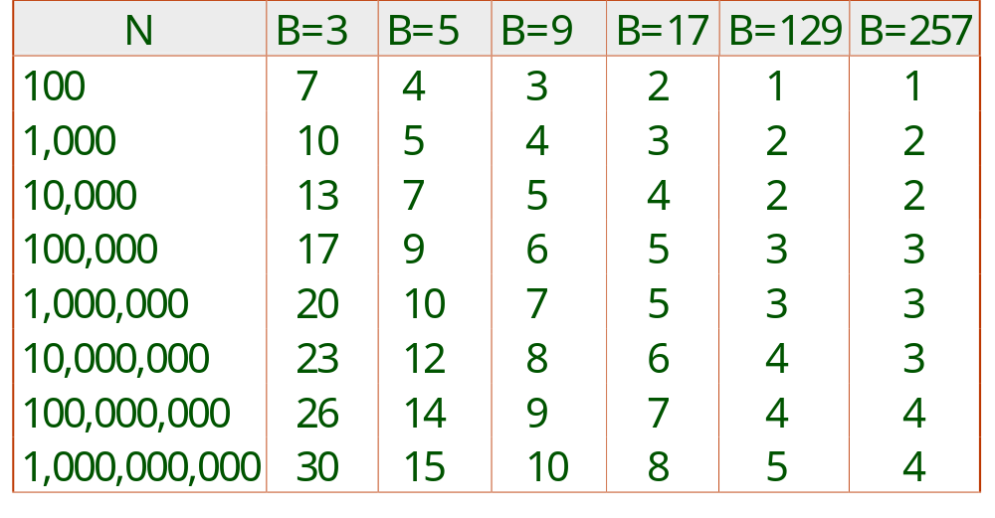
Number of Passes of External Sort
Notes:
9

Slide 10
I/O for External Merge Sort
… longer runs often means fewer passes!
Actually, do I/O a page at a time
In fact, read a block of pages sequentially!
Suggests we should make each buffer (input/output) be a block of pages.
  But this will reduce fan-out during merge passes!
  In practice, most files still sorted in 2-3 passes.
  Typical DBMSs sort 1M records of size 100 bytes in 15 minutes

Slide 11
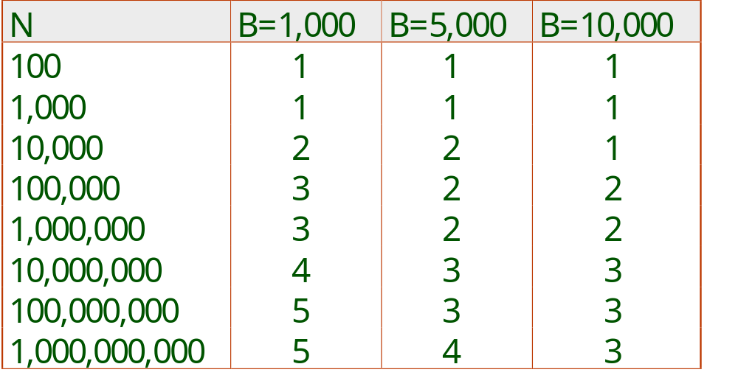
Number of Passes of Optimized Sort
Block size = 32, initial pass produces runs of size 2B.
Notes:
13

Slide 12
Double Buffering
To reduce wait time for I/O request to complete, can prefetch into `shadow block’.
  Potentially, more passes; in practice, most files still sorted in 2-3 passes.
INPUT 1
INPUT 1'
INPUT 2
OUTPUT
INPUT 2'
OUTPUT'
b
Disk
INPUT k
block size
Disk
INPUT k'
B main memory buffers, k-way merge

Slide 13
Using B+ Trees for Sorting
Scenario: Table to be sorted has B+ tree index on sorting column(s).
Idea: Can retrieve records in order by traversing leaf pages.
Is this a good idea?
Cases to consider:
  B+ tree is clustered Good idea!
  B+ tree is not clustered Could be a very bad idea!
Notes:
15

Slide 14
Clustered B+ Tree Used for Sorting
Cost: root to the left-most leaf, then retrieve all leaf pages (Alternative 1)
If Alternative 2 is used? Additional cost of retrieving data records: each page fetched just once.
Index
(Directs search)
Data Entries
("Sequence set")
Data Records
Always better than external sorting!
Notes:
16

Slide 15
Unclustered B+ Tree Used for Sorting
Alternative (2) for data entries; each data entry contains rid of a data record. In general, one I/O per data record!
Index
(Directs search)
Data Entries
("Sequence set")
Data Records
Notes:
17

Slide 16
Summary
External sorting is important; DBMS may dedicate part of buffer pool for sorting!
External merge sort minimizes disk I/O cost:
  Pass 0: Produces sorted runs of size B (# buffer pages). Later passes: merge runs.
  # of runs merged at a time depends on B, and block size.
  Larger block size => smaller # runs merged.
Clustered B+ tree is good for sorting; unclustered tree is usually very bad.
Notes:
19

